Slide 1
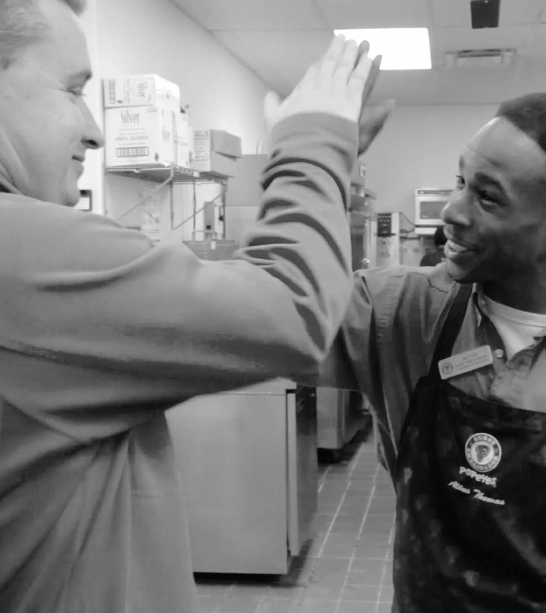
ABOUT THIS DECK
This is an template deck for you to use to create your own Snagajob presentations.
Before starting your own, make sure you “Make a copy” of it by going to File → Make a copy, and then rename appropriately. You can find links to icons you may use throughout this template OR by visiting the Visual Design section on The Spot. There are also a few additional variations of slides. To view these click Slide → Apply Layout or clicking on the “New slide” button (plus sign w/ dropdown) in the top-left corner. Use these slides to inform the decisions you make about color, type and general layout.
If you have any questions please feel free to reach out to the Product Marketing Team.
COLORS PRIMARILY USED
Marketplace orange #f36f21 | Platform blue #0067b1 | Accent lines #b7b7b7 (dark gray 1)

Slide 2
Test Automation
What You Need to Know

Slide 3
TL;DR
PLEASE NOTE
There are 4 different transition slides with different background images. Click the “New slide” button in the top-left corner of the page or press CTRL+M to see the options for additional transition slides.
QA is being swallowed by DevOps, but it’s not dead.
Test automation is easy, but doing it right is not.

Slide 4
I make it easier to produce quality features.

Slide 5

Checking + Exploring = Chimp + Training?

Slide 6
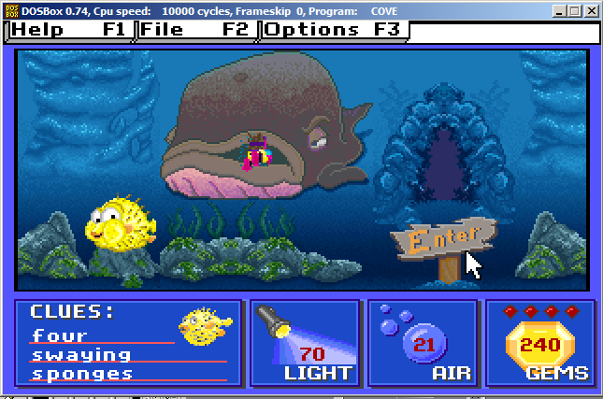
DevOps = Dev + Ops +QA

Slide 7



Core Competencies
PLEASE NOTE
To switch out icons, right-click on the icon you want to replace and select Replace image… and navigate to the icon library to find which new icon you’d like to replace the original icon with.
Any awesome QA professional has at least two (2).
ANALYST
“QA Brain”
ASSURER
Systems thinker.
AMBASSADOR
Facilitator.

Slide 8
AUTOMATION
is what exactly?

Slide 9
Three key areas:
Where automation is being introduced into the testing lifecycle.
Unit.
Not my job.
Acceptance.
API’s
GUI
Data?
Regression.
Huge.

Slide 10
Watch out.
Ask why. - automating the wrong stuff = no improved quality
Built to last. - tests can quickly become obscured in false negatives
KISS. - overly-complex tests are brittle and impossible to maintain

Slide 11

Gotcha’s
PLEASE NOTE
To switch out icons, right-click on the icon you want to replace and select Replace image… and navigate to the icon library to find which new icon you’d like to replace the original icon with.
Common pitfalls for automated testing efforts.
Nobody asks “Why?” If automation isn’t reducing bugs, you’re targeting the wrong stuff. Ask “why” five (5) times before automating.
Not built to last Quick automation wins often come at the cost of poor scalability or inflexibility. Brittle tests go in the trash.
Not simple. An overly complicated framework means poor knowledge transfer and lack of transparency to business.

Slide 12
Some QA models:
Not really related to automation.
QA manager => CTO || Center for Process Excellence. NOT the Director of Development or Enginering.
Pair programming. Promotes empathy and collaboration.
Etsy. Developers can’t pass crappy code.

Slide 13
CapOne CI pipeline.
PLEASE NOTE
Adjust length of orange progress line to meet Action item currently in progress. Also make sure that the current Action item is the only item in bold.
A QA dream.
1
Pull request
3
Regression tests
5
Code promoted.
2
VM fires up
4
Acceptance tests
Notes:
CapOne: Whenever any developer does a Git commit, Jenkins receives a callback, calls Grunt(a JavaScript task runner), which autostarts a collection of Windows vm images in Virtualbox (hypervisor running locally) - then you can run a bunch of JavaScript-based

Slide 14




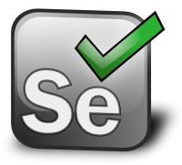




Tools
Some cool stuff to look out for.
Tools:
-Git, AWS, Jenkins - automated builds, Docker
-SauceLabs/SeleniumGrid, GhostInspector, Appium(Java/TestNG or Ruby/Cucumber) or Exxpresso-Java OR instruments-Swift
-
Demo

Slide 15
Thank you

